Slide 1


Slide 2

UNIT5: FOOD AND HEALTH
LESSON 7: WRITING - A FOOD BLOG – page 69.

Slide 3

EXERCISE 1: Check the meanings of the words in the glossary. Then read Sally’s blog. What does she have for the starter? What is her favourite part of the meal? – page 69.
GLOSSARY
tuna red pepper olives ingredients
chop starter main course dessert

Slide 4
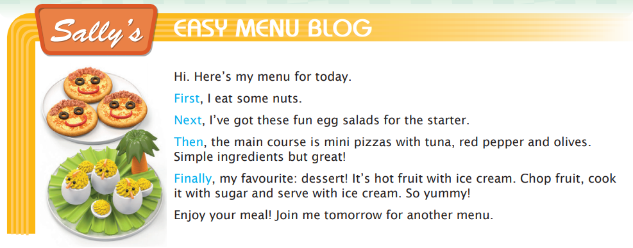
EXERCISE 1: Check the meanings of the words in the glossary. Then read Sally’s blog. What does she have for the starter? What is her favourite part of the meal?
What does she have for the starter?
→ She has egg salads.
What is her favourite part of the meal?
→ Her favourite part of the meal is the dessert.

Slide 5
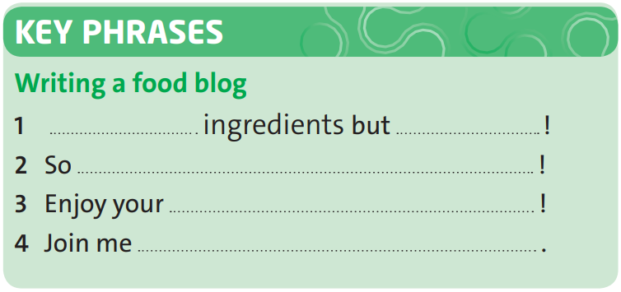
EXERCISE 2: Complete the Key Phrases with words from Sally's blog.
Simple
great
yummy
meal
tomorrow

Slide 6
EXERCISE 3: Look at the words and phrases in blue in the blog. Which two have the same meaning?
Which two have the same meaning?
→ Next and Then

Slide 7
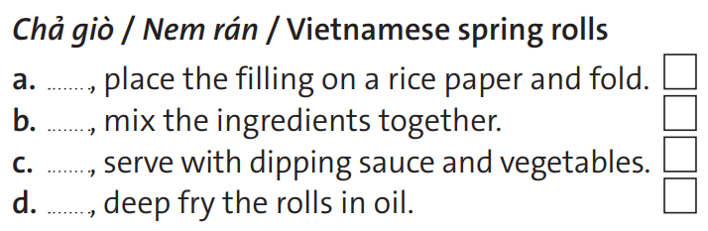
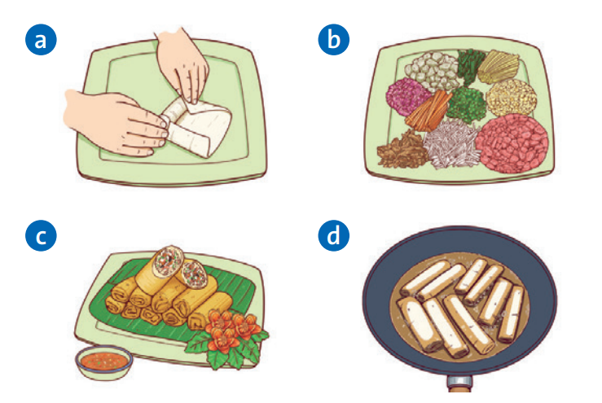
EXERCISE 4: Order pictures and sentences a-d. Then complete the sentences with the words in exercise 3.
Then/ Next
2
1
First
4
Finally
Next/ Then
3

Slide 8
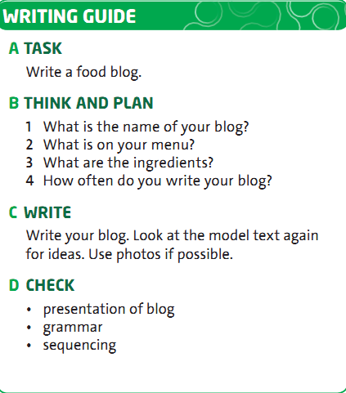
EXERCISE 5: Follow the steps in the writing guide.

Slide 9


- Learn by heart all structures.
- Workbook: Exercises page 41.
Prepare the new lesson:
CLIL – Science: Food and nutrients – page 70.

Slide 10
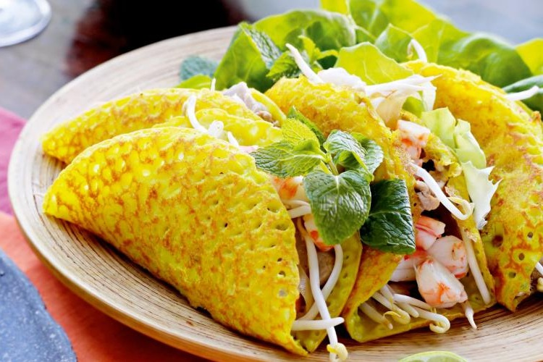
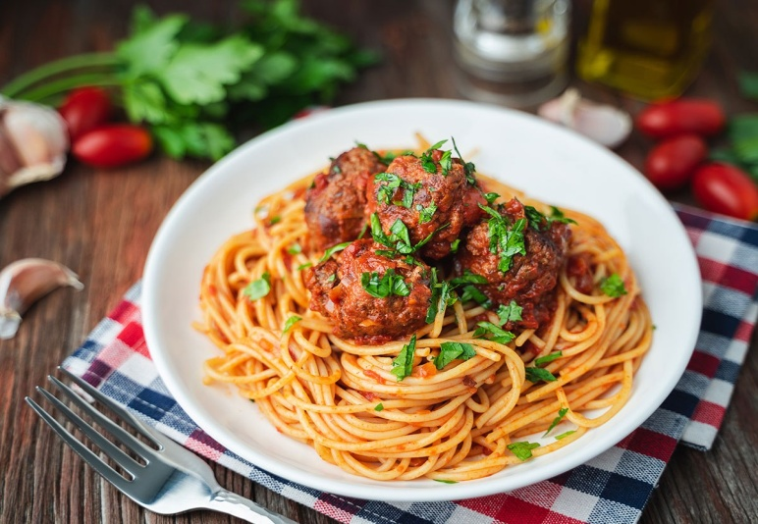
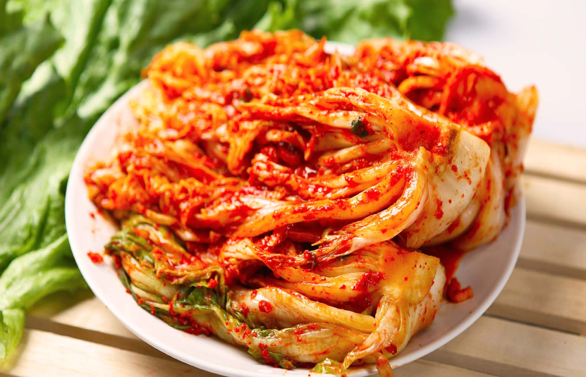
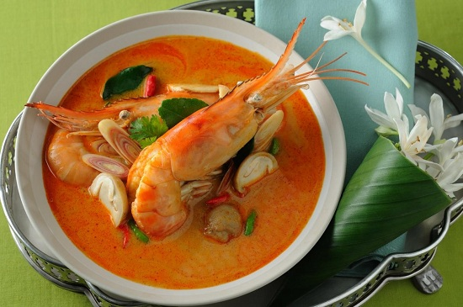
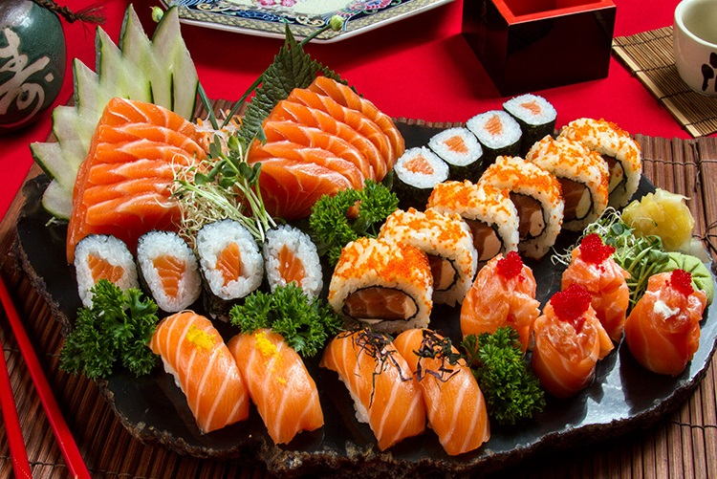
Pancake (Vietnamese food)
Pasta (Italian food)
Kimchi (Korean food)
Tom Yum (Thai food)
Sushi (Japanese food)

Slide 11
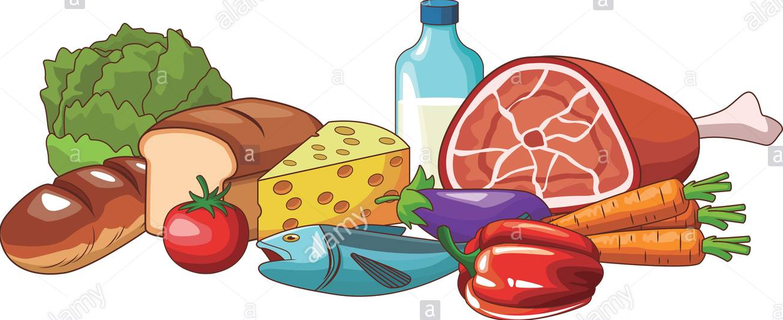
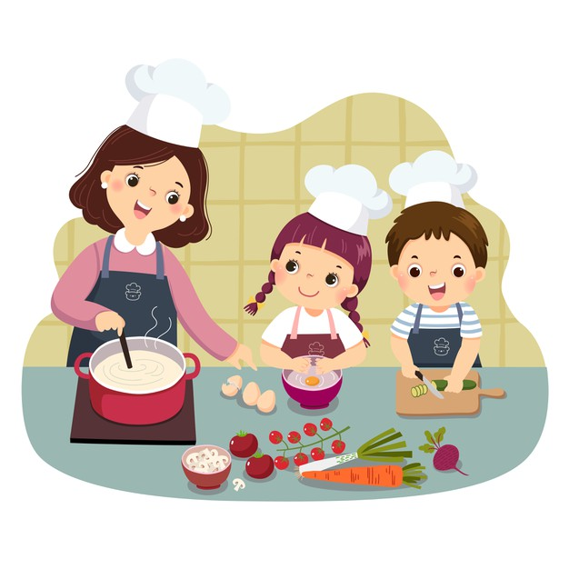
What things can you cook?
What would you like to cook?
Do you think it's important to learn how to cook?

